Slide 1


The Kubernetes Learning Slides
v0.15.1
last update: 2023/01/02 Note: we’re working to get the slides up-to-date and clean-up outdated content (2023/01/03)

Slide 2
Latest Updates
June 15.
Kubernetes Sequence Diagram added →
June 14.
The Pod Cheat Sheet →

Slide 3
Latest Updates
June 1.
Get Started with RSaaS →
May 18.
New Self Learning Site →
April 1.
Troubleshooting →
Feb. 15.
Headless Service vs. ClusterIP →
Feb. 10.
Practical Kubernetes Problems →
Jan. 27.
Cloud Native Storage on K8s →

Slide 4
About this project
GET STARTED with Practical Kubernetes Problems →
For more information feel free to join us on slack →
If you’d like to become a CKA(D), please ask to join the CKA(D)s channel, everyone in the group can add you to the CKA(D)s channel

Slide 5
How to prepare for trainings (1)
The Practical Kubernetes Training →
Optional: you need an account on GCP with billing enabled
Get started with $300 free credits →
Create a project and enable GKE service
Install gcloud SDK / CLI: →
Source: https://kubernauts.gitbooks.io/kubernauts-kubernetes-training-courses/content/courses/novice.html

Slide 6
How to prepare for trainings (2)
Other options:
Rancher k3d / k3s →
Rancher rke →
Multipass Rancher →
Multipass Kubeadm →
Multipass k3s →
tk8ctl →
TK8 Cattle AWS →
TK8 Cattle EKS →

Slide 7
How to prepare for trainings (3)
Checkout the code of Practical Kubernetes Problems $ git clone https://github.com/kubernauts/practical-kubernetes-problems.git
Checkout the code of Kubernetes By Example $ git clone https://github.com/openshift-evangelists/kbe
Visit the Kubernetes By Example Site https://kubebyexample.com/
Checkout the code of Kubernetes By Action $ git clone https://github.com/luksa/kubernetes-in-action.git
Checkout the code of K8s intro tutorials $ git clone https://github.com/mrbobbytables/k8s-intro-tutorials
Source: https://kubernauts.gitbooks.io/kubernauts-kubernetes-training-courses/content/courses/novice.html

Slide 8
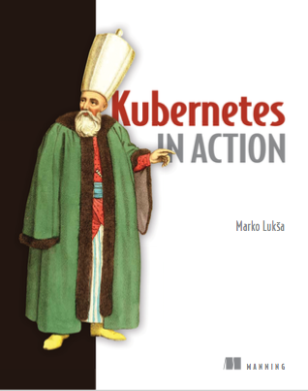
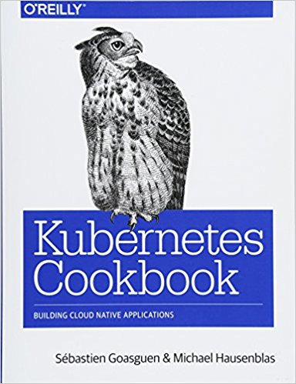
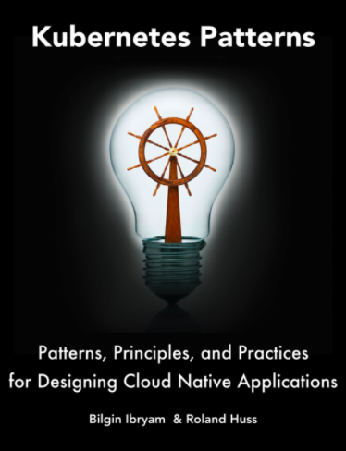
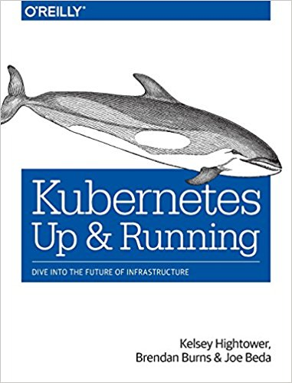
Kubernetes Learning Resources List
Again: almost everything you need to know about Kubernetes & more:
https://goo.gl/Rywkpd
Recommended Books and references:

Slide 9
TOPICS (1)
What is Kubernetes (“k8s” or “kube”)
Kubernetes Architecture
Core Concepts of Kubernetes
Kubernetes resources explained
Application Optimization on Kubernetes
Kubernetes effect on the software development life cycle
Local and Distributed Abstractions and Primitives
Container Design Patterns and best practices
Deployment and release strategy with Kubernetes

Slide 10
TOPICS (2)
Kubernetes v1.8: A Comprehensive Overview →
Getting started with Kubernetes
Deploying and Updating App with Kubernetes
Deploy more complex apps and data platforms on k8s

Slide 11
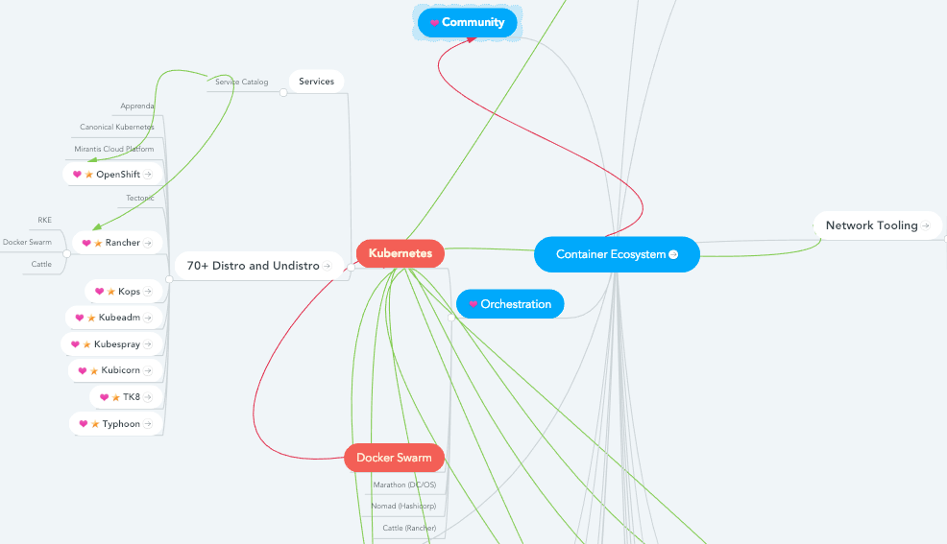
Kubernetes & the Container Ecosystem
https://www.mindmeister.com/929803117/container-ecosystem?fullscreen=1

Slide 12
Agenda

Slide 13
Agenda, day 1
Agenda
What is Kubernetes
Deployment and release strategy (in short)
Getting started (general)
Security
Exercises
more Exercises

Slide 14
Agenda, day 2
Agenda
HA Installation and Multi-Cluster Management
Tips & Tricks, Practice Questions
Advanced Exercises
Load Testing on K8s with Apache Jmeter
Kafka on K8s with Strimzi and Confluent OS
TK8 Cattle AWS vs. Cattle EKS
TK8 Special with TK8 Web
TroubleShooting & Questions

Slide 15
What is Kubernetes?

Slide 16
What Is Kubernetes?
Kubernetes is Greek for "helmsman", your guide through unknown waters, nice but not true :-)
Kubernetes is the linux kernel of distributed systems
Kubernetes is the linux of the cloud!
Kubernetes is a platform and container orchestration tool for automating deployment, scaling, and operations of application containers.
Kubernetes supports, Containerd, CRI-O, Kata containers (formerly clear and hyper) and Virtlet
Notes:
Note: A container runtime is a CRI (Container Runtime Interface) compatible application that executes and manages containers!

Slide 17
Containers?
What is a Container Engine?
Where are the differences between Docker, CRI-O or Containerd runtimes?
How does Kubernetes work with container runtimes?
Which is the best solution?
Linux Container Internals by Scott McCarty → →
Container Runtimes and Kubernetes by Fahed Dorgaa →
Kubernetes Runtime Comparison →
Notes:
Note: A container runtime is a CRI (Container Runtime Interface) compatible application that executes and manages containers!

Slide 18
How Kubernetes works?

Slide 19
How Kubernetes works?
In Kubernetes, there is a master node and multiple worker nodes, each worker node can handle multiple pods. Pods are just a bunch of containers clustered together as a working unit. You can start designing your applications using pods. Once your pods are ready, you can specify pod definitions to the master node, and how many you want to deploy. From this point, Kubernetes is in control. It takes the pods and deploys them to the worker nods.
Source: https://itnext.io/successful-short-kubernetes-stories-for-devops-architects-677f8bfed803

Slide 20
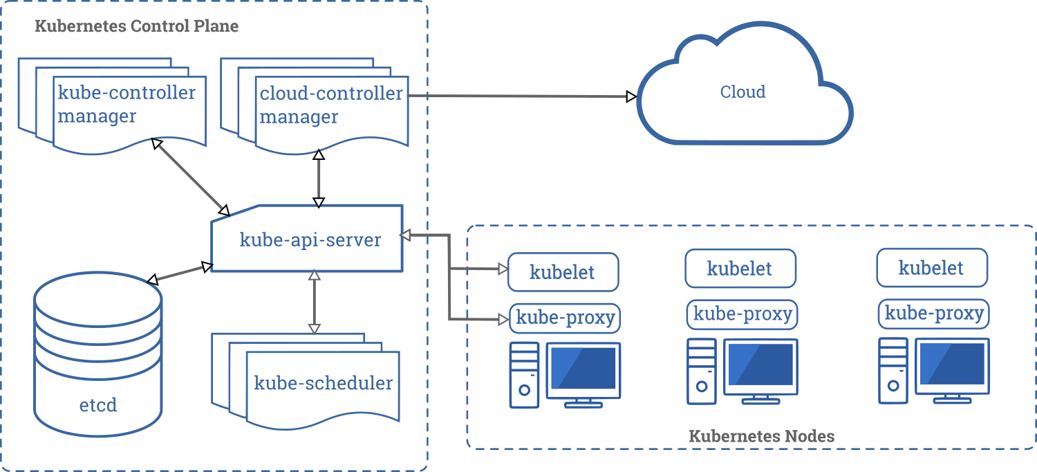
Kubernetes Components
Source: https://kubernetes.io/docs/concepts/overview/components/#master-components

Slide 21
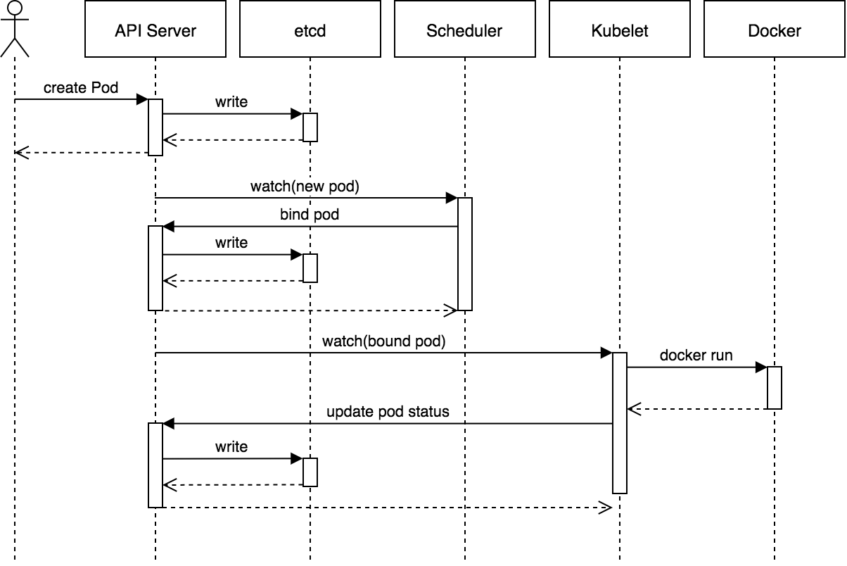
A Typical Flow: How K8s API works
Source: https://blog.heptio.com/core-kubernetes-jazz-improv-over-orchestration-a7903ea92ca

Slide 22
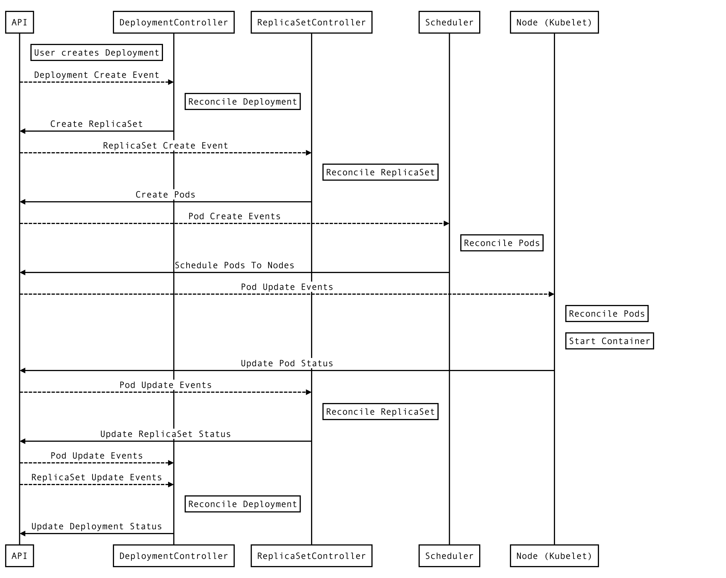
Kubernetes Component Flow
Source: https://medium.com/payscale-tech/imperative-vs-declarative-a-kubernetes-tutorial-4be66c5d8914
Notes:
kubectl translates your imperative command into a declarative Kubernetes Deployment object. A Deployment is a higher-level API that allows rolling updates (see below).
kubectl sends the Deployment to the Kubernetes API server, kube-apiserver, which runs in-cluster.
kube-apiserver saves the Deployment to etcd (a distributed key-value store), which also runs in-cluster, and responds to kubectl.
Asynchronously, the Kubernetes controller manager, kube-controller-manager, which watches for Deployment events (among others), creates a ReplicaSet from the Deployment and sends it to kube-apiserver. A ReplicaSet is a version of a Deployment. During a rolling update, a new ReplicaSet will be created and progressively scaled out to the desired number of replicas, while the old one is scaled in to zero.
kube-apiserver saves the ReplicaSet to etcd.
Asynchronously, kube-controller-manager, creates two Pods (or more if we scale out) from the ReplicaSet and sends them to kube-apiserver. Pods are the basic unit of Kubernetes. They represent one or several containers sharing a Linux cgroup and namespaces.
kube-apiserver saves the Pods to etcd.
Asynchronously, the Kubernetes scheduler, kube-scheduler, which watches for Pod events, updates each Pod to assign it to a Node and sends them back to kube-apiserver.
kube-apiserver saves the Pods to etcd.
Finally, the kubelet that runs on the assigned Node, always watching, actually starts the container.

Slide 23
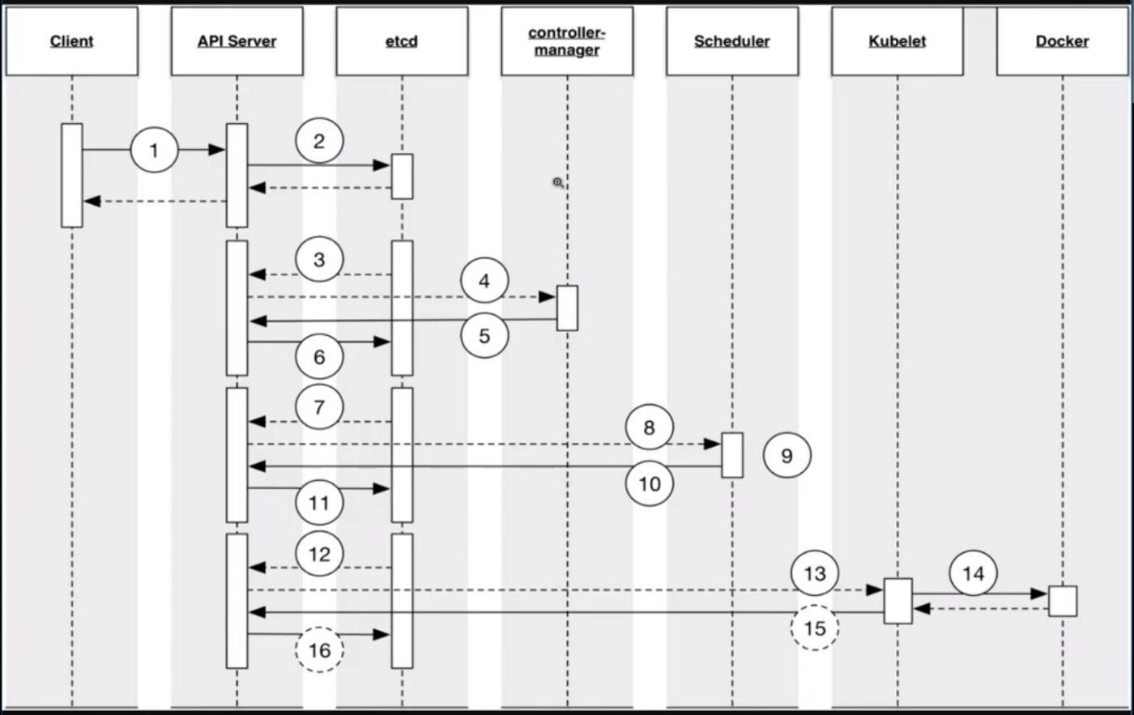
Kubernetes Component Flow
Source: https://medium.com/cloud-heroes/exploring-the-flexibility-of-kubernetes-9f65db2360a0
Notes:
Client sends a request for a Deployment to the API Server (for example using kubectl create -f deployment.yml)
API Server persists the Deployment to etcd; etcd returns 200 to API Server; API Server returns 200 to Client (obviously, the work isn’t done here, there is a lot of background asynchronous stuff that happens next)
Controller Manager has a watch against the API Server; it sees that a Deployment has been created and it populates that Informer to the SharedCache
Deployment Controller sees the Deployment, pulls it off the queue, creates a ReplicaSet and persists the ReplicaSet object back to the API Server and back to etcd
Repeat Step 3 for ReplicaSet
ReplicaSet Controller sees the ReplicaSet, pulls it off the queue, creates X number of Pods and persists the Pods object back to the API Server and back to etcd
Repeat Step 3 for Pods (but Scheduler does this part now)
Scheduler sees the unscheduled pods, and executes its business logic to fill out the nodeName field in the pod’s Spec with the name of the Schedulable Node and persists the scheduled Pods object back to the API Server and back to etcd
Repeat Step 3 for Pods (but Kubelet this time)
Kubelet (on the scheduled node) sees it’s supposed to have a Pod running on its machine and talks with the container runtime (Docker, etc.) to make that happen

Slide 24
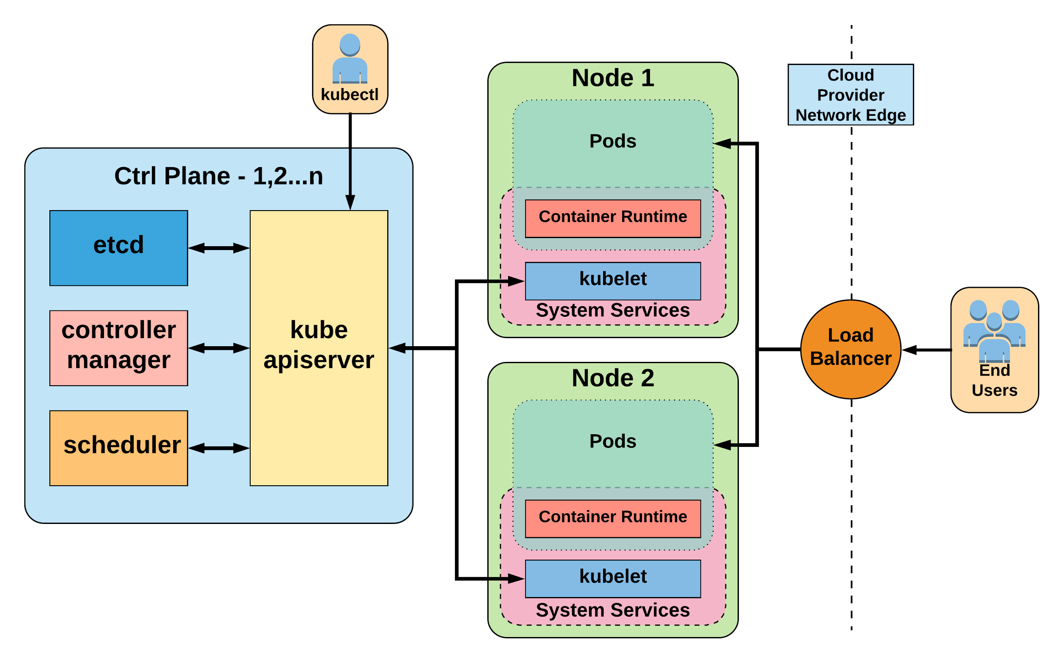
Kubernetes Architecture Overview
Source: Introduction to Kubernetes
Notes:
Architecture Overview
Masters - Acts as the primary control plane for Kubernetes. Masters are responsible at a minimum for running the API Server, scheduler, and cluster controller. They commonly also manage storing cluster state, cloud-provider specific components and other cluster essential services. Nodes - Are the ‘workers’ of a Kubernetes cluster. They run a minimal agent that manages the node itself, and are tasked with executing workloads as designated by the master.

Slide 25
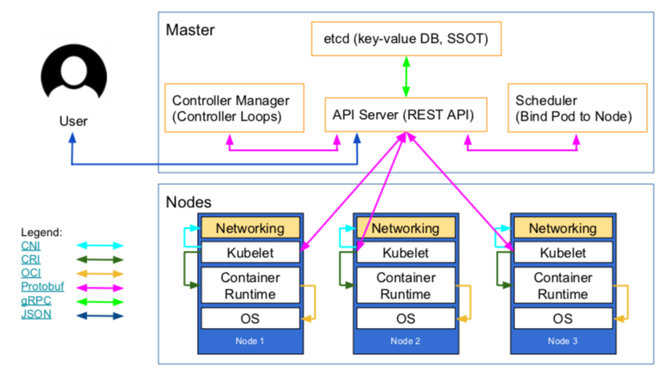
Kubernetes’ High-Level Architecture Overview
Source: https://www.weave.works/blog/what-does-production-ready-really-mean-for-a-kubernetes-cluster

Slide 26
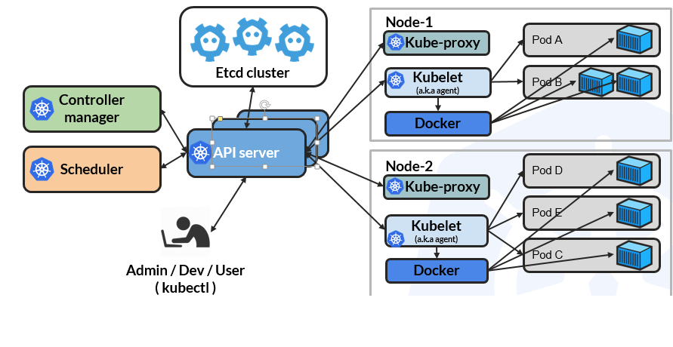
Kubernetes’ High-Level Architecture Overview

Slide 27
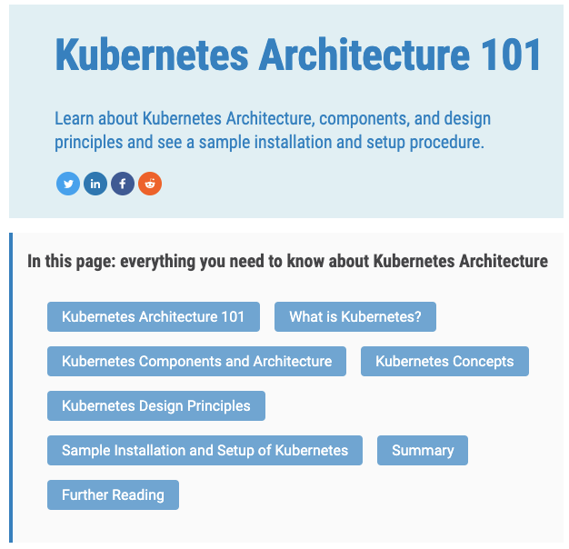
Kubernetes Architecture 101
Source: https://www.aquasec.com/wiki/display/containers/Kubernetes+Architecture+101
Notes:
Kube-apiserver
Gate keeper for everything in kubernetes
EVERYTHING interacts with kubernetes through the apiserver
Etcd
Distributed storage back end for kubernetes
The apiserver is the only thing that talks to it
Kube-controller-manager
The home of the core controllers
kube-scheduler
handes placement

Slide 28
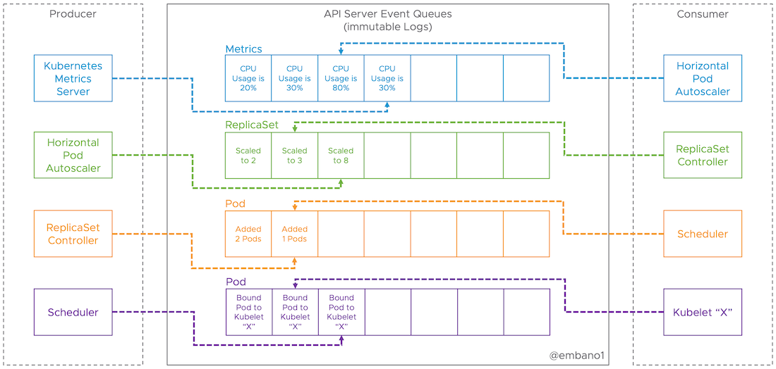
Kubernetes is like Kafka: Event-Driven Architecture
Kubernetes: “Autonomous processes reacting to events from the API server”.
Source: Events, the DNA of Kubernetes
Notes:
How to understand Kubernetes
Think of the API server as an immutable (replicated) log (or queue), each representing a stream of events. Events are facts that can be causally related (happened-before) or not related at all (then we say they happened concurrently). etcd is important for the durability of events, but an implementation detail.
All processes (controllers), e.g. the scheduler, deployment controller, endpoint controller, Kubelet, etc. can be understood as producers and/or consumers of events (consumers can be producers as well, and vice versa).
Consumers specify the objects (and optionally namespace) they want to receive events from the API server. This is called a watch in Kubernetes. Think of the combination of object+namespace as a dedicated (virtual) event queue the API server handles.
Consumers and producers don’t know about each other as they’re fully decoupled (by the queue) and autonomous. This makes the whole system extremely scalable, robust and extensible (adaptable to change).
Thus, by design, it’s a fully asynchronous and eventually consistent platform. Information takes time to propagate from producers(s) to consumers(s). The diagram below shows this where the Horizontal Pod Autoscaler hasn’t caught up with the events coming from the metrics server, which also affects the downstream chain of producers and consumers in our example.

Slide 29
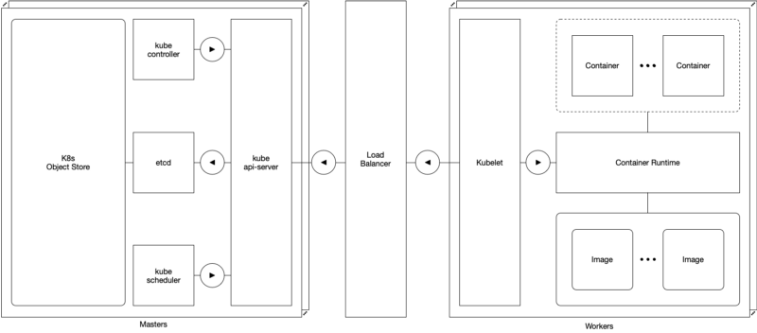
Kubernetes HA
Don’t miss: https://medium.com/@dominik.tornow/kubernetes-high-availability-d2c9cbbdd864

Slide 30
Core Concepts of Kubernetes (1)
Pod →
Label and selectors →
Controllers
Deployments →
ReplicaSet →
ReplicationController →
DaemonSet →
Service →

Slide 31
Core Concepts of Kubernetes (2)
StatefulSets →
ConfigMaps →
Secrets →
Persistent Volumes (attaching storage to containers) →
Life Cycle of Applications in Kubernetes →
Updating Pods
Rolling updates
Rollback

Slide 32
Kubernetes resources explained (1)
 | Resource (abbr.) [API version] | Description
 | Namespace* (ns) [v1] | Enables organizing resources into non-overlapping groups (for example, per tenant)
Deploying Workloads | Pod (po) [v1] ReplicaSet ReplicationController Job CronJob DaemonSet StatefulSet Deployment | The basic deployable unit containing one or more processes in co-located containers Keeps one or more pod replicas running The older, less-powerful equivalent of a ReplicaSet Runs pods that perform a completable task Runs a scheduled job once or periodically Runs one pod replica per node (on all nodes or only on those matching a node selector) Runs stateful pods with a stable identity Declarative deployment and updates of pods
Source: Kubernetes in Action book by Marko Lukša

Slide 33
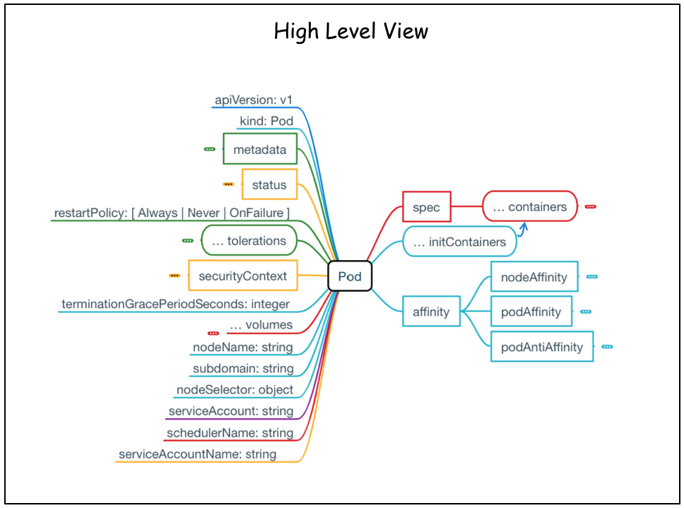
The Pod Cheat Sheet
Source: The Pod Cheat Sheet by the awesome Jimmy Song

Slide 34
Kubernetes resources explained (2)
 | Resource (abbr.) [API version] | Description
Services | Service (svc) [v1] Endpoints (ep) [v1] Ingress (ing) [extensions/v1beta1] | Exposes one or more pods at a single and stable IP address and port pair Defines which pods (or other servers) are exposed through a service Exposes one or more services to external clients through a single externally reachable IP address
Config | ConfigMap (cm) [v1] Secret [v1] | A key-value map for storing non-sensitive config options for apps and exposing it to them Like a ConfigMap, but for sensitive data
Storage | PersistentVolume* (pv) [v1] PersistentVolumeClaim (pvc) [v1] StorageClass* (sc) [storage.k8s.io/v1] | Points to persistent storage that can be mounted into a pod through a PersistentVolumeClaim A request for and claim to a PersistentVolume Defines the type of storage in a PersistentVolumeClaim
Source: Kubernetes in Action book by Marko Lukša

Slide 35
Kubernetes resources explained (4)
 | Resource (abbr.) [API version] | Description
Scaling | HorizontalPodAutoscaler (hpa) [autoscaling/v2beta1**] PodDisruptionBudget (pdb) [policy/v1beta1] | Automatically scales number of pod replicas based on CPU usage or another metric Defines the minimum number of pods that must remain running when evacuating nodes
Resources | LimitRange (limits) [v1] ResourceQuota (quota) [v1] | Defines the min, max, default limits, and default requests for pods in a namespace Defines the amount of computational resources available to pods in the namespace
Cluster state | Node* (no) [v1] Cluster* [federation/v1beta1] ComponentStatus* (cs) [v1] Event (ev) [v1] | Represents a Kubernetes worker node A Kubernetes cluster (used in cluster federation) Status of a Control Plane component A report of something that occurred in the cluster
Source: Kubernetes in Action book by Marko Lukša

Slide 36
Kubernetes resources explained (4)
 | Resource (abbr.) [API version] | Description
Security | ServiceAccount (sa) [v1] Role [rbac.authorization.k8s.io/v1] ClusterRole* [rbac.authorization.k8s.io/v1] RoleBinding [rbac.authorization.k8s.io/v1] ClusterRoleBinding* [rbac.authorization.k8s.io/v1] PodSecurityPolicy* (psp) [extensions/v1beta1] NetworkPolicy (netpol) [networking.k8s.io/v1] CertificateSigningRequest* (csr) [certificates.k8s.io/v1beta1] | An account used by apps running in pods Defines which actions a subject may perform on which resources (per namespace) Like Role, but for cluster-level resources or to grant access to resources across all namespaces Defines who can perform the actions defined in a Role or ClusterRole (within a namespace) Like RoleBinding, but across all namespaces A cluster-level resource that defines which security- sensitive features pods can use Isolates the network between pods by specifying which pods can connect to each other A request for signing a public key certificate
Ext. | CustomResourceDefinition* (crd) [apiextensions.k8s.io/v1beta1] | Defines a custom resource, allowing users to create instances of the custom resource
Source: Kubernetes in Action book by Marko Lukša

Slide 37
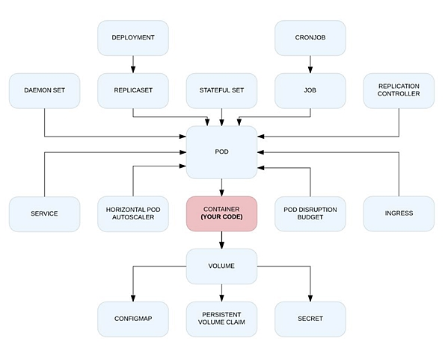
Application dependency on Kubernetes primitives
Source: Kubernetes effect by Bilgin Ibryam

Slide 38
Deployment and Release Strategy

Slide 39
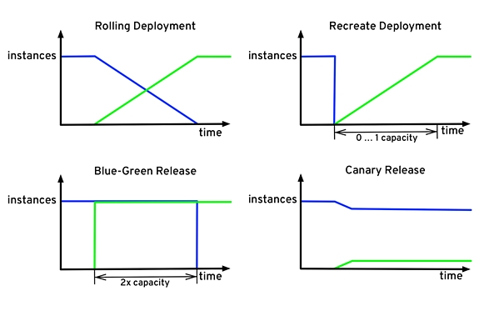
Deployment and Release Strategy with Kubernetes
Source: Kubernetes effect by Bilgin Ibryam

Slide 40
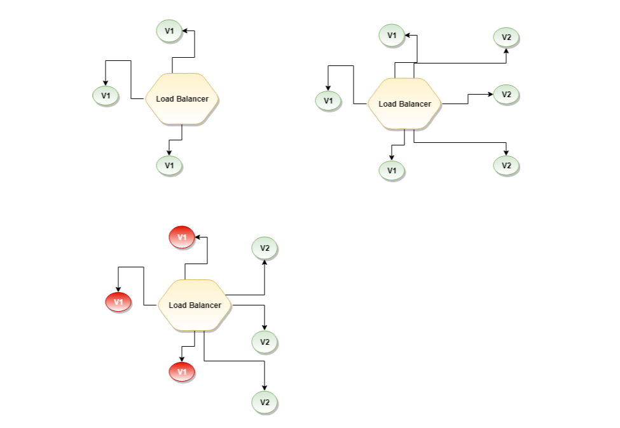
Kubernetes Deployment Strategy Types
Source: Kubernetes Deployment Strategy Types

Slide 41
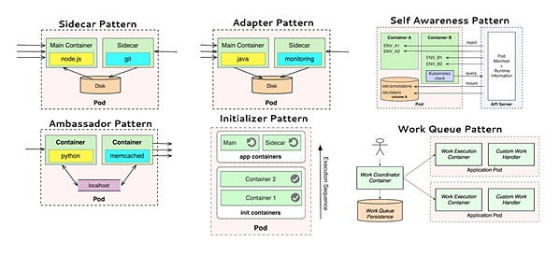
Local and distributed abstractions and primitives
Source: Kubernetes effect by Bilgin Ibryam

Slide 42
Getting Started

Slide 43
Getting started with Kubernetes
Kubernetes.IO documentation →
Kubernetes Bootcamp →
Install Kubernetes CLI kubectl →
Create a local cluster with
Docker For Desktop →
Minikube →
MiniShift →
DinD → or Kind →

Slide 44
Local Development Environment using Minikube
Follow this Minikube tutorial by the awesome Abhishek Tiwari
https://abhishek-tiwari.com/local-development-environment-for-kubernetes-using-minikube/

Slide 45
Getting started with Kubernetes
Create a Kubernetes cluster on AWS
Kubeadm →
TK8 & TK8EKS →

Slide 46
Install Kubernetes CLI kubectl
On macOS: brew install kubectl
On linux and windows follow the official documentation: https://kubernetes.io/docs/tasks/tools/install-kubectl/
“kubectl version” gives the client and server version
“which kubectl”
alias k=’kubectl’
Enable shell autocompletion (e.g. on linux):
echo "source <(kubectl completion bash)" >> ~/.bashrc
Notes:
Note: the kubectl bash completion doesn’t work out of the box if you set alias k=’kubectl’
You need to do:
kubectl completion bash | sed -e 's/kubectl/k/g'
On Mac the above doesn’t work, to fix this to the following: kubectl completion bash | sed -e 's/kubectl/k/g' >> ~/.kubectl-short-completion.bash
Source .kubectl-short-completion.bash in your .bash_profile:
source ~/.kubectl-short-completion.bash

Slide 47
K8s helper tools
Great kubectl helpers by Ahmet Alp Balkan
kubectx and kubens →
Kubernetes prompt for bash and zsh
kube-ps1 →
Kubed-sh (kube-dash) →
Kubelogs →
kns and ktx →
K9s →
The golden Kubernetes Tooling and helpers list →

Slide 48
Useful aliases
alias k="kubectl"
alias g="gcloud"
alias kx="kubectx"
alias kn="kubens"
alias kon="kubeon"
alias koff="kubeoff"
alias kcvm="kubectl config view --minify"
alias kgn="kubectl get nodes"
alias kgp="kubectl get pods"
Notes:
merge 2 kube config files: KUBECONFIG=~/.kube/config:./kube.config kubectl config view --flatten > config
cp config ~/.kube/config Or: cp ~/.kube/config ~/.kube/config.bak && \
KUBECONFIG=/path/to/kubeconfig:~/.kube/config.bak kubectl config view --flatten > ~/.kube/config

Slide 49
Kubectl commands, Cheat Sheets
Switch to another namespace on the current context (cluster):
kubectl config set-context <cluster-name> --namespace=efk
Switch to another cluster
kubectl config use-context <cluster-name>
Merge kube configs
cp ~/.kube/config ~/.kube/config.bak
KUBECONFIG=./kubeconfig.yaml:~/.kube/config.bak kubectl config view --flatten > ~/.kube/config
Again: use kubectx and kubens, it makes the life easier :-)
A great Cheat Sheet by Denny Zhang →
Kubectl: most useful commands by Matthew Davis →

Slide 50
Create a Kubernetes cluster on GKE (1)
You need an account on GCP with billing enabled
Create a project and enable GKE service
Install gcloud SDK / CLI:
https://cloud.google.com/sdk/
Source:

Slide 51
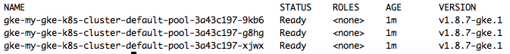
Create a Kubernetes cluster on GKE (2)
gcloud projects create kubernauts-trainings
gcloud config set project kubernauts-trainings
gcloud container clusters create my-training-cluster --zone=us-central1-a
Note: message=The Kubernetes Engine API is not enabled for project training-220218. Please ensure …
Kubectl get nodes

Slide 52
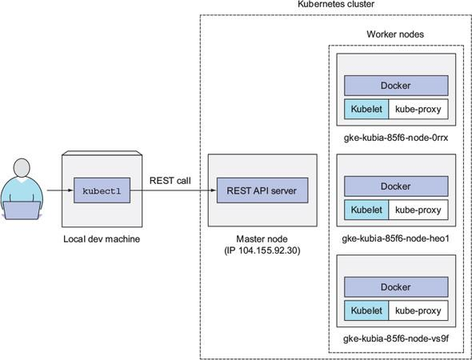
How you’re interacting with your three-node Kubernetes cluster
Source: Kubernetes in Action book by Marko Lukša

Slide 53
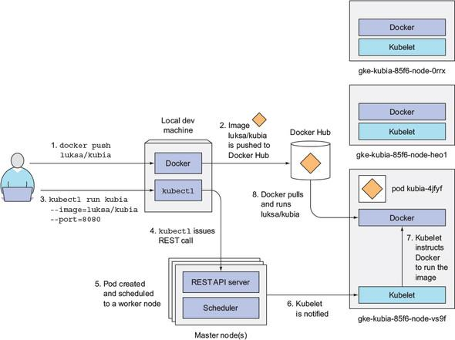
Running the container image in Kubernetes
Source: Kubernetes in Action book by Marko Lukša

Slide 54
Create a Kubernetes cluster on GKE (3)
List your clusters
gcloud container clusters list
Set a default Compute Engine zone
gcloud config set compute/zone us-central1-a
Define a standard project with your ProjectID
gcloud config set project kubernauts-trainings
Access the Kubernetes dashboard
kubectl proxy →
Source:

Slide 55
Create a Kubernetes cluster on GKE (4)
Login to one of the nodes
gcloud compute ssh <node-name>
Get more information about a node
kubectl describe node <node name>
Delete / clean up your training cluster
gcloud container clusters delete my-training-cluster --zone=europe-west3-a
Note: deleting a cluster doesn’t delete your storage / disks on GKE, you’ve to delete them manually

Slide 56
Create a Kubernetes cluster on AWS
Create a Kubernetes cluster on AWS
Typhoon →
Kubeadm →
Kops FastStart →
Kubicorn →
TK8 →
Kubernetes Cluster API →

Slide 57
Create a Kubernetes cluster on ACS
Create a Kubernetes cluster on ACS
Please refer to Kubernetes CookBook
Source:

Slide 58
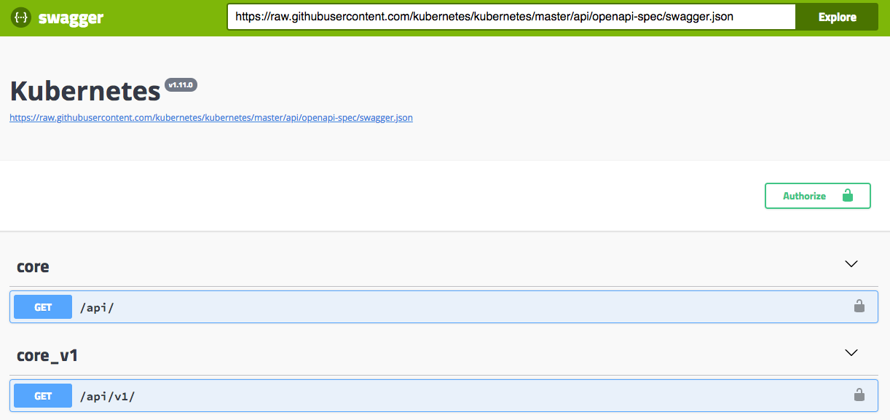
Kubernetes API Groups, OpenAPI and Swagger UI (2)

Slide 59
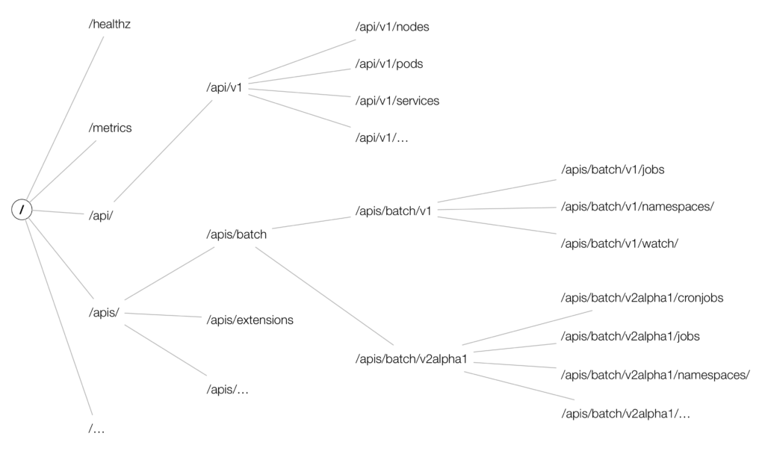
Kubernetes API Groups, OpenAPI and Swagger UI (3)
Enjoy the Kubernetes API deep dive →

Slide 60
Kubernetes API Groups, OpenAPI and Swagger UI (4)
Get all API resources supported by your K8s cluster:
$ kubectl api-resources -o wide
Get API resources for a particular API group: $ kubectl api-resources --api-group apps -o wide Get more info about the particular resource: $ kubectl explain configmap
Source: https://akomljen.com/kubernetes-api-resources-which-group-and-version-to-use/
Notes:
Please note that explain may show an old group/version, but you can explicitly set it with --api-version, for example, kubectl explain replicaset --api-version apps/v1.

Slide 61
Kubernetes API Groups, OpenAPI and Swagger UI (1)
Install Swagger UI on Minikube / Minishift / Tectonic
k run swagger-ui --image=swaggerapi/swagger-ui:latest
On Tectonic →
k expose deployment swagger-ui --port=8080 --external-ip=172.17.4.101 --type=NodePort
On Minikube →
k expose deployment swagger-ui --port=8080 --external-ip=$(minikube ip) --type=NodePort
Use swagger.json to explore the API
Notes:
Note: this doesn’t work on minikube: minikube start --extra-config=apiserver.Features.Enable-SwaggerUI=true k proxy --port=8080
http://127.0.0.1:8080/swagger-ui

Slide 62
Kubernetes API Groups, OpenAPI and Swagger UI (5)
Get all API versions supported by your K8s cluster:
$ kubectl api-versions
Check if a particular group/version is available for some resource: $ kubectl get deployments.v1.apps -n kube-system
Source: https://akomljen.com/kubernetes-api-resources-which-group-and-version-to-use/

Slide 63
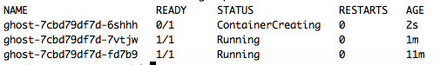
Play with Simple Apps on Kubernetes
Start the Ghost micro-blogging platform
kubectl run ghost --image=ghost:0.9
kubectl expose deployments ghost --port=2368 --type=LoadBalancer
k expose deployment ghost --port=2368 --external-ip=$(minikube ip) --type=NodePort
kubectl get svc
kubectl get deploy
kubectl edit deploy ghost (change the nr. of replicas to 3)

Slide 64
Play with Simple Apps on Kubernetes
Log into the pod
kubectl exec -it ghost-xxx bash
Get the logs from the pod
kubectl logs ghost-xxx
Delete the Ghost micro-bloging platform
kubectl delete deploy ghost
Get the cluster state
kubectl cluster-info dump --all-namespaces --output-directory=$PWD/cluster-state

Slide 65
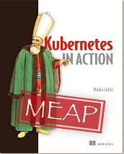
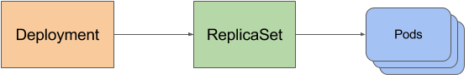
Deploying and Updating Apps with Kubernetes
Please read and understand this great free chapter from Kubernetes in Action book by Marko Lukša.

Slide 66
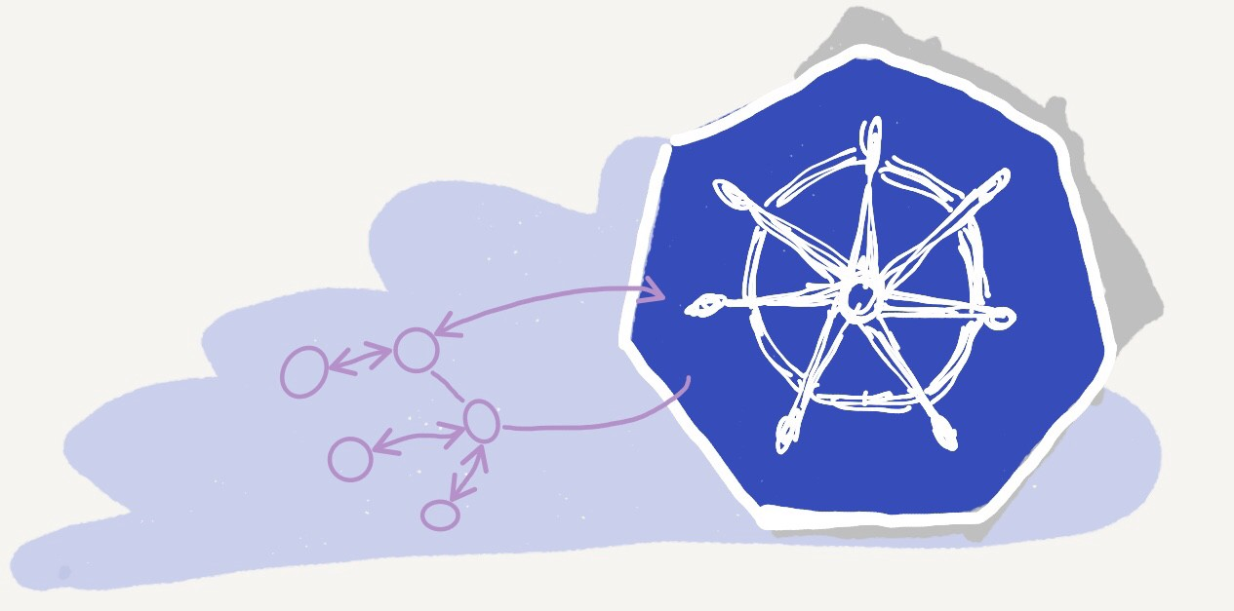
Understanding Kubernetes NodePort vs LoadBalancer vs Ingress (1)
Source: https://medium.com/@metaphorical/internal-and-external-connectivity-in-kubernetes-space-a25cba822089

Slide 67
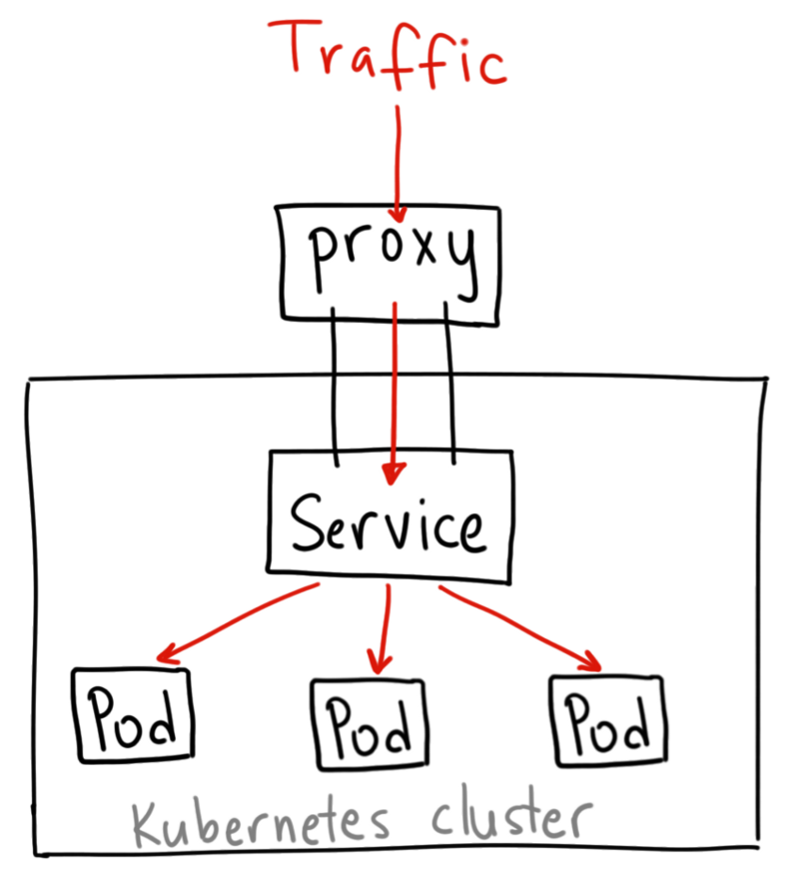
Understanding Kubernetes NodePort vs LoadBalancer vs Ingress (2)
Source: https://medium.com/google-cloud/kubernetes-nodeport-vs-loadbalancer-vs-ingress-when-should-i-use-what-922f010849e0

Slide 68
Shedding Light on Managing External Access to the Services
3 Ways to expose your services in Kubernetes
NodePort
External LoadBalancer
MetalLB consideration
Ingress
Ingress Controller
Ingress resource
More + →
More ++ →

Slide 69
Kubernetes ingress with Ambassador
Ambassador is an open source, Kubernetes-native microservices API gateway built on the Envoy Proxy.
Ambassador is awesome and powerful, eliminates the shortcomings of Kubernetes ingress capabilities
Ambassador is easily configured via Kubernetes annotations
Ambassador is in active development by datawire.io
Needles to say Ambassador is open source →
Source: https://blog.getambassador.io/kubernetes-ingress-nodeport-load-balancers-and-ingress-controllers-6e29f1c44f2d

Slide 70
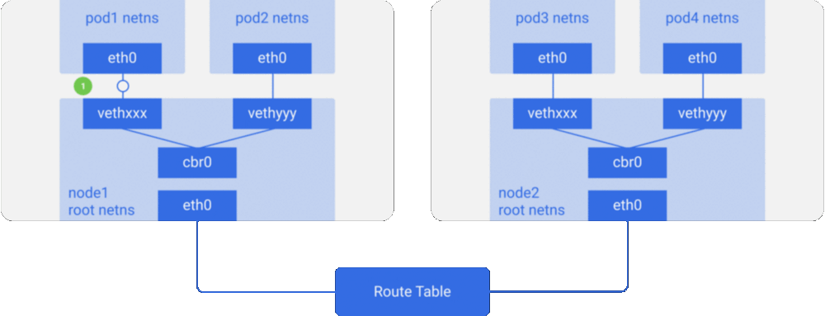
Understanding Kubernetes Networking (I)
Source: https://itnext.io/an-illustrated-guide-to-kubernetes-networking-part-1-d1ede3322727

Slide 71
Understanding Kubernetes Networking
Every Pod has a unique IP
Pod IP is shared by all the containers in this Pod, and it’s routable from all the other Pods.
All containers within a pod can communicate with each other.
All Pods can communicate with all other Pods without NAT.
All nodes can communicate with all Pods (and vice-versa) without NAT.
The IP that a Pod sees itself as, is the same IP that others see it as.
Source: https://itnext.io/an-illustrated-guide-to-kubernetes-networking-part-1-d1ede3322727

Slide 72
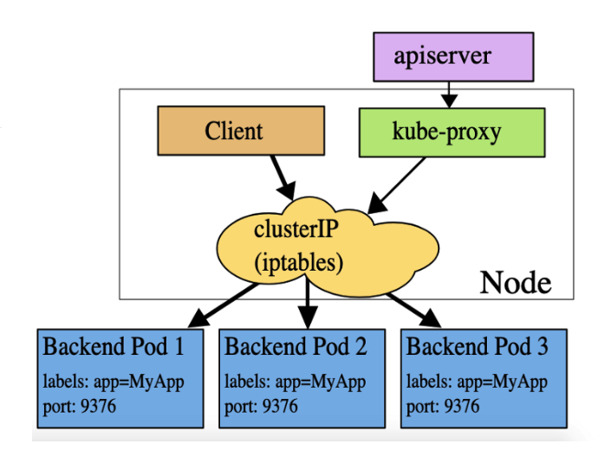
Kubernetes Headless vs. ClusterIP and traffic distribution
Source: https://medium.com/devopslinks/kubernetes-headless-service-vs-clusterip-and-traffic-distribution-904b058f0dfd

Slide 73
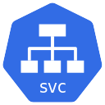


Kubernetes Headless vs. ClusterIP and traffic distribution
client
client
svc with head (VIP)
headless svc
ClusterIP= 10.43.153.249
ClusterIP= None
Load balancing
Stickiness
https://github.com/arashkaffamanesh/practical-kubernetes-problems#headless-services-for-stickiness

Slide 74


Ingress Controller (Traefik)
Traefik sends req. to pods via round robin
DNS /etc/hosts
client
192.168.64.23
1- Client looks up my.ghost.svc
2- Client sends HTTP GET req. to controller with my.ghost.svc In host header

Slide 75
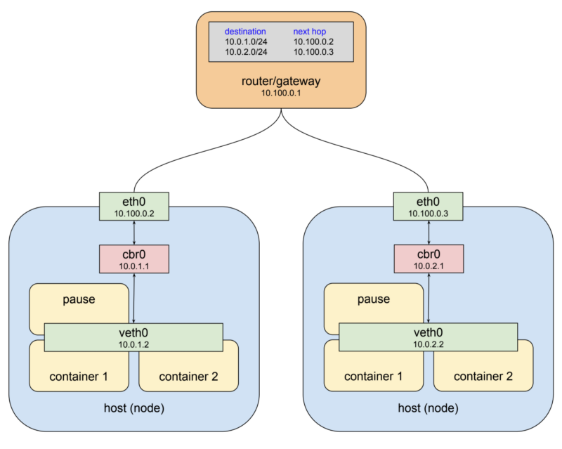
Understanding Kubernetes Networking (II)
Source: https://medium.com/@tao_66792/how-does-the-kubernetes-networking-work-part-1-5e2da2696701

Slide 76
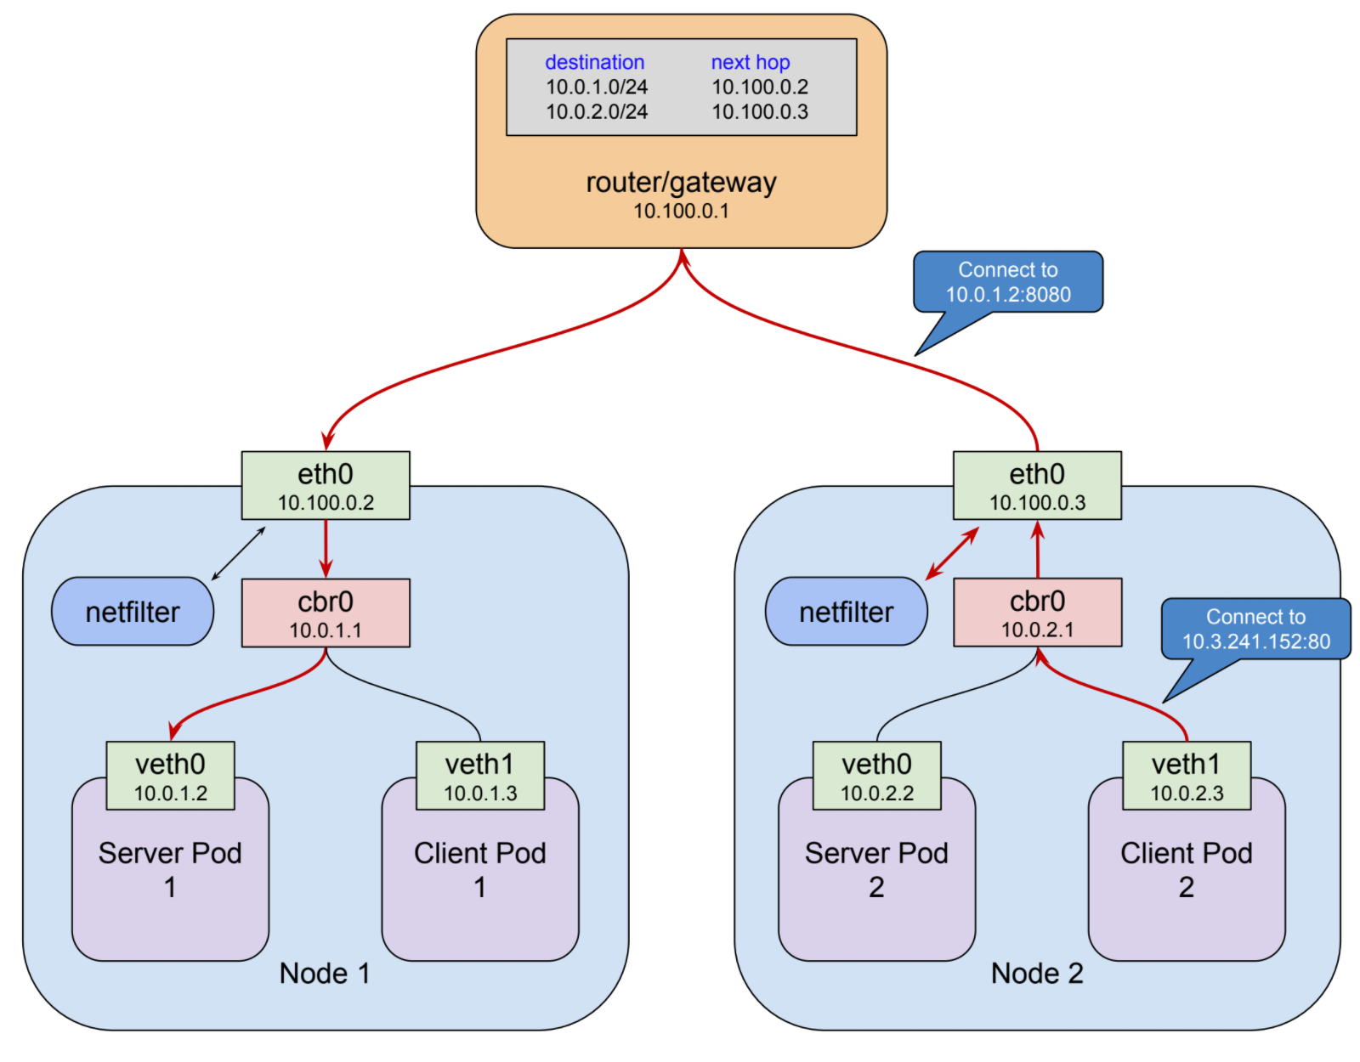
Understanding Kubernetes Networking (III)
Source: https://medium.com/google-cloud/understanding-kubernetes-networking-pods-7117dd28727

Slide 77
MetallB
How can you have same experience of using a load balancer service type on your bare metal cluster just like public clouds?
This is what Metallb aims to solve.
Layer 2/ARP mode: Only one worker node can respond to the Load Balancer IP address
BGP mode: This is more scalable, all the worker nodes will respond to the Load Balancer IP address, this means that even of one of the worker nodes is unavailable, other worker nodes will take up the traffic. This is one of the advantages over Layer 2 mode but you need a BGP router on your network (open source routers Free Range Router, Vyos)
Source: https://metallb.universe.tf/

Slide 78
MetallB
Work around for the Layer 2 disadvantage is to use a CNI plugin that supports BGP like Kuberouter
Kuberouter will then advertise the LB IP via BGP as ECMP route which will be available via all the worker nodes.
Source: https://github.com/cloudnativelabs/kube-router/blob/master/docs/user-guide.md#advertising-ips

Slide 79
MetallB Sample ARP Mode Configmap
apiVersion: v1
kind: ConfigMap
metadata:
name: config
data:
config: |
address-pools:
- name: my-ip-space
protocol: layer2
addresses:
- 84.200.xxx.xxx-84.200.xxx.xxx

Slide 80
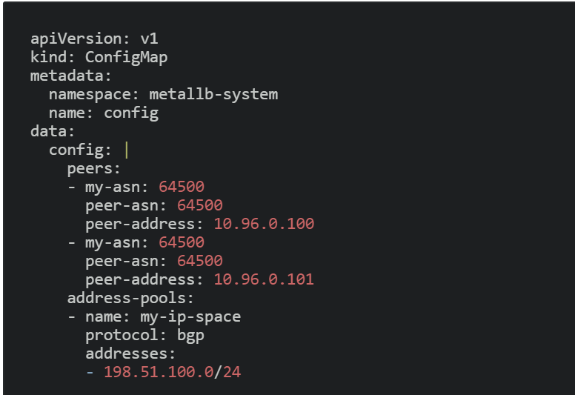
MetallB Sample BGP Mode Configmap

Slide 81
Security

Slide 82
Best Practices (I)
Make sure to always scan all your Docker Images and Containers for potential threats
Never use any random Docker Image(s) and always use authorised images in your environment
Categorise and accordingly split up your cluster through Namespace
Use Network Policies to implement proper network segmentation and Role Based Access Control(RBAC) to create administrative boundaries between resources for proper segregation and control
Source: https://blog.kubernauts.io/kubernetes-best-practices-d5cbef02fe1b

Slide 83
Best Practices (II)
Limit SSH access to Kubernetes nodes, and Ask users to use kubectl exec instead.
Never use Passwords, or API tokens in plain text or as environment variables, use secrets instead
Use non-root user inside container with proper host to container, UID and GID mapping
Source: https://blog.kubernauts.io/kubernetes-best-practices-d5cbef02fe1b

Slide 84

Managing Secrets in Kubernetes
If you’re serious about security in Kubernetes, you need a secret management tool that provides a single source of secrets, credentials, attaching security policies, etc.
In other words, you need Hashicorp Vault.
Source: https://blog.kubernauts.io/managing-secrets-in-kubernetes-with-vault-by-hashicorp-f0db45cc208a

Slide 85
Exercises

Slide 86
kubectl cheat sheet

Slide 87
kubectl cheat sheet
→ https://github.com/dennyzhang/cheatsheet-kubernetes-A4
$ kubectl get events --sort-by=.metadata.creationTimestamp # List Events sorted by timestamp
$ kubectl get services --sort-by=.metadata.name # List Services Sorted by Name
$ kubectl get pods --sort-by=.metadata.name
$ kubectl get endpoints
$ kubectl explain pods,svc
$ kubectl get pods -A # --all-namespaces
$ kubectl get nodes -o jsonpath='{.items[*].spec.podCIDR}'
$ kubectl get pods -o wide
$ kubectl get pod my-pod -o yaml --export > my-pod.yaml
$ kubectl get pods --show-labels # Show labels for all pods (or other objects)
$ kubectl get pods --sort-by='.status.containerStatuses[0].restartCount'
$ kubectl cluster-info
$ kubectl api-resources
$ kubectl get apiservice

Slide 88

Kubernetes by Example
By the awesome Kubernaut Michael Hausenblas
Hands-On introduction to Kubernetes →
Note: you can run the examples on minikube, OpenShift, GKE or any other Kubernetes Installations.

Slide 89

Kubernetes Presentations and Tutorials by Bob Killen
By the awesome Bob Killen
Introduction to Kubernetes → (The best introduction which I know about!)
Kubernetes Tutorials →

Slide 90
More Exercises

Slide 91
Exercise 1: Create a deployment for nginx ...
Create a deployment running nginx version 1.12.2 that will run in 2 pods
Scale this to 4 pods
Scale it back to 2 pods
Upgrade the nginx image version to 1.13.8
Check the status of the upgrade
Check the history
Undo the upgrade
Delete the deployment
Source:

Slide 92
Exercise 1: Create a deployment for nginx ...
Create nginx version 1.12.2 with 2 pods
kubectl run nginx --image=nginx:1.12.2 --replicas=2 --record
Scale to 5 pods
kubectl scale --replicas=5 deployment nginx
Scale back to 2 pods
kubectl scale --replicas=2 deployment nginx
Upgrade the nginx image to 1.13.8 version
kubectl set image deployment nginx nginx=nginx:1.13.8
Source:

Slide 93
Exercise 1: Create a deployment for nginx ...
Check the status of the upgrade
kubectl rollout status deployment nginx
Get the history of the actions
kubectl rollout history deployment nginx
Undo / rollback the upgrade
kubectl rollout undo deployment nginx
Delete the deployment
k delete deploy/nginx
Source:

Slide 94
Exercise 1: Create a deployment for nginx from a manifest file
Create the deployment with a manifest:
kubectl create -f nginx.yaml
Note: Pods, services, configmaps, secrets in our examples are all part of the /api/v1 API group, while deployments are part of the /apis/extensions/v1beta1 API group.
The group an object is part of is what is referred to as apiVersion in the object specification, available via the API reference.
$ cat nginx.yaml
apiVersion: extensions/v1beta1
kind: Deployment
metadata:
name: nginx
labels:
app: nginx
spec:
replicas: 2
selector:
matchLabels:
app: nginx
template:
metadata:
labels:
app: nginx
spec:
containers:
- name: nginx
image: nginx:1.12.2
ports:
- containerPort: 80

Slide 95
Exercise 1: Create a deployment for nginx ...
Edit the deployment: change the replicas to 5 and image version to 1.13.8
kubectl edit deployment nginx
Get some info about the deployment and ReplicaSet
kubectl get deploy
kubectl get rs
k get pods -o wide (set alias k=’kubectl’)
k describe pod nginx-xyz

Slide 96
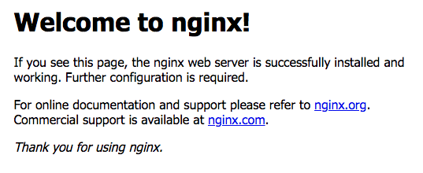
Exercise 1: Create a service to the pods with expose
kubectl expose deployments nginx --port=80 --type=LoadBalancer
k get svc

Slide 97
Exercise 2: write an ingress rule ...
Write an ingress rule that redirects calls to /foo to one service and to /bar to another
k create -f ingress.yaml
$ cat ingress.yaml
apiVersion: extensions/v1beta1
kind: Ingress
metadata:
name: test
annotations:
ingress.kubernetes.io/rewrite-target: /
spec:
rules:
- host: kubernauts.io
http:
paths:
- path: /foo
backend:
serviceName: s1
servicePort: 80
- path: /bar
backend:
serviceName: s2
servicePort: 80

Slide 98
Exercise 3: deployment, RC & RS
kubectl run kubia --image=luksa/kubia --port=8080 --generator=run/v1
kubectl run kubia --image=luksa/kubia --port=8080
k get svc
k get pods
k get rc
k get rs
kubectl describe rs kubia-57478bf476
k get svc
k expose rc kubia --type=LoadBalancer --name kubia-http
k expose rs kubia --type=LoadBalancer --name kubia-http2
k expose rs kubia-57478bf476 --type=LoadBalancer --name kubia-http2
k get pods
k scale rc kubia --replicas=3
k get pods
k scale rs kubia-57478bf476 --replicas=3 —> can’t work, you should scale the deployment
k scale deployment kubia --replicas=3 K port-forward kubia-xxxxx 8888:8080
http://127.0.0.1:8888/
Note: the kubia image is from the Kubernetes in Action book by Marko Lukša

Slide 99
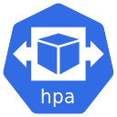



Exercise 4: horizontal pod autoscaling (hpa)
1- Get / Check metrics every 30 seconds (default)
2- Threshold met?
0- metrics-server pod
3- ask deployment to change
the number of replicas
4- deploy new pods
… another pod?

Slide 100
Exercise 4: horizontal pod autoscaling (hpa)
On GKE:
kubectl run ghost --image=ghost:0.9 --requests="cpu=100m"
k expose deployment ghost --port=2368 --type=LoadBalancer
k autoscale deployment ghost --min=1 --max=4 --cpu-percent=10
export loadbalancer_ip=$(k get svc -o wide | grep ghost | awk '{print $4}')
while true; do curl http://$loadbalancer_ip:2368/ ; done
k get hpa -w
k describe hpa
On Minikube (hpa doesn’t work for now on minikube → bug??)
minikube addons enable heapster
kubectl run ghost --image=ghost:0.9 --requests="cpu=100m"
k expose deployment ghost --port=2368 --type=NodePort --external-ip=$(minikube ip)
k autoscale deployment ghost --min=1 --max=4 --cpu-percent=10
while true; do curl http://$(minikube ip):2368/ ; done
k get hpa -w
k describe hpa
→ unable to get metrics for resource cpu

Slide 101
Exercise 5: deploying replicated stateful applications
gcloud compute disks create --size=1GiB --zone=us-central1-a pv-a
gcloud compute disks create --size=1GiB --zone=us-central1-a pv-b
gcloud compute disks create --size=1GiB --zone=us-central1-a pv-c
k create -f persistent-volumes-gcepd.yaml
k create -f kubia-service-headless.yaml
k create -f kubia-statefulset.yaml
k get po
k get po kubia-0 -o yaml
k get pvc
k proxy
k create -f kubia-service-public.yaml
k proxy
Note: This example is from the Chapter 10 of the Kubernetes in Action book by Marko Lukša

Slide 102
Exercise 6: Play with RBAC
minikube stop
minikube start --extra-config=apiserver.Authorization.Mode=RBAC
k create ns foo
k create ns bar
k run test --image=luksa/kubectl-proxy -n foo
k run test --image=luksa/kubectl-proxy -n bar
k get po -n foo
k get po -n bar
k exec -it test-xxxxxxxxx-yyyyy -n foo sh
k exec -it test-yyyyyyyyy-xxxxx -n bar sh
curl localhost:8001/api/v1/namespaces/foo/services
curl localhost:8001/api/v1/namespaces/bar/services
cd Chapter12/
cat service-reader.yaml
k create -f service-reader.yaml -n foo
k create role service-reader --verb=get --verb=list --resource=services -n bar
k create rolebinding test --role=service-reader --serviceaccount=foo:default -n foo
k create rolebinding test --role=service-reader --serviceaccount=bar:default -n bar
k edit rolebinding test -n foo
k edit rolebinding test -n bar
Note: This example is from the Chapter 12 of the Kubernetes in Action book by Marko Lukša

Slide 103
Practical K8s Problems
https://github.com/arashkaffamanesh/practical-kubernetes-problems

Slide 104
Tips & Tricks

Slide 105
Tips & Tricks (I)
List all Persistent Volumes sorted by their name
kubectl get pv | grep -v NAME | sort -k 2 -rh
Find which pod is taking max CPU
kubectl top pod
Find which node is taking max CPU
kubectl top node
Getting a Detailed Snapshot of the Cluster State
kubectl cluster-info dump --all-namespaces > cluster-state
Save the manifest of a running pod
kubectl get pod name -o yaml --export > pod.yml
Save the manifest of a running deployment
kubectl get deploy name -o yaml --export > deploy.yml
Use dry-run to create a manifest for a deployment
kubectl run ghost --image=ghost --restart=Always --expose --port=80 --output=yaml --dry-run > ghost.yaml
k apply -f ghost.yaml
k get all
Delete evicted pods
kubectl get po -A -o json | jq '.items[] | select(.status.reason!=null) | select(.status.reason | contains("Evicted")) | "kubectl delete po \(.metadata.name) -n \(.metadata.namespace)"' | xargs -n 1 bash -c

Slide 106
Tips & Tricks (II)
Find all deployments which have no resource limits set
kubectl get deploy -o json |
jq ".items[] | select(.spec.template.spec.containers[].resources.limits==null) | {DeploymentName:.metadata.name}"
Create a yaml for a job
kubectl run --generator=job/v1 test --image=nginx --dry-run -o yaml
Find all pods in the cluster which are not running
kubectl get pod --all-namespaces -o json | jq '.items[] | select(.status.phase!="Running") | [ .metadata.namespace,.metadata.name,.status.phase ] | join(":")'
List the top 3 nodes with the highest CPU usage
kubectl top nodes | sort --reverse --numeric -k 3 | head -n3
List the top 3 nodes with the highest MEM usage
kubectl top nodes | sort --reverse --numeric -k 5 | head -n3
Get rolling Update details for deployments
kubectl get deploy -o json |
jq ".items[] | {name:.metadata.name} + .spec.strategy.rollingUpdate"
List pods and its corresponding containers
kubectl get pods -o='custom-columns=PODS:.metadata.name,CONTAINERS:.spec.containers[*].name'

Slide 107
Tips & Tricks (III)
Troubleshoot a faulty node
Check the status of kubelet
systemctl status kubelet
If it's running, check the logs locally with
journalctl -u kubelet
If it's not running, you probably need to start it:
systemctl restart kubelet
If a node is not getting pods schedule to it, describe the node
kubectl describe node <nodename>
If your pods are stuck in pending, check your scheduler services:
systemctl status kube-scheduler
Or by scheduler pods in a kubeadm / rancher cluster
kubectl get pods -n kube-system
kubectl logs kube-scheduler-master -n kube-system
Get quota for each node: kubectl get nodes --no-headers | awk '{print $1}' | xargs -I {} sh -c 'echo {}; kubectl describe node {} | grep Allocated -A 5 | grep -ve Event -ve Allocated -ve percent -ve -- ; echo'
Get nodes which have no taints kubectl get nodes -o json | jq -r '.items[] | select(.spec.taints == null) | "\(.metadata.name)"'
Find out the unused/unupdated deployments in your clusters kubectl get deploy --all-namespaces -ojson | jq '.items[] | "\(.metadata.namespace) \(.metadata.name) \(.spec.replicas) \(.status.conditions[0].lastUpdateTime)"'

Slide 108
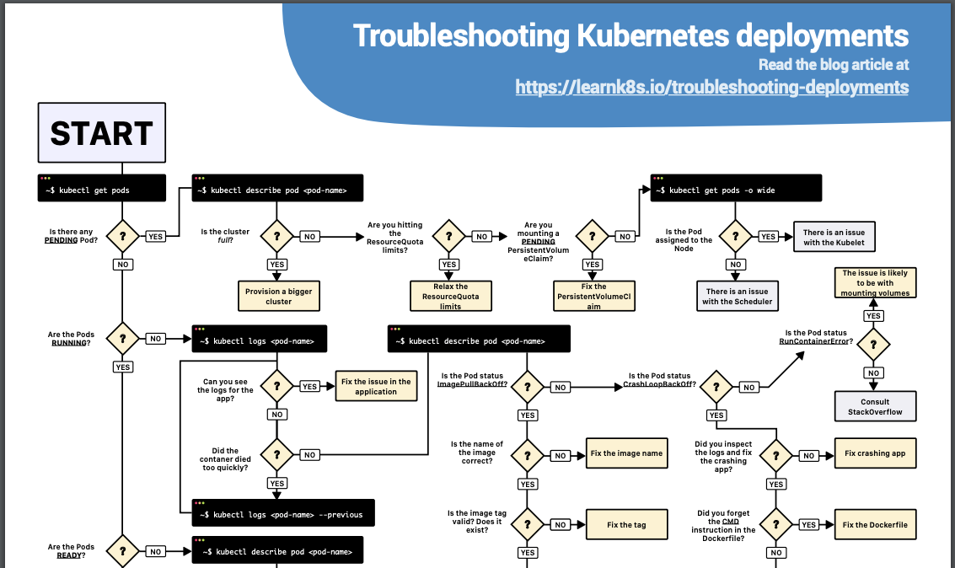
Tips & Tricks (IV)
https://learnk8s.io/troubleshooting-deployments

Slide 109
K8s Practice Questions

Slide 110
Practice Questions (I)
Create a yaml for a job that calculates the value of pi
Create an Nginx Pod and attach an EmptyDir volume to it.
Create an Nginx deployment in the namespace “kube-cologne” and corresponding service of type NodePort . Service should be accessible on HTTP (80) and HTTPS (443)
Add label to a node as "arch=gpu"
Create a Role in the “conference” namespace to grant read access to pods.
Create a RoleBinding to grant the "pod-reader" role to a user "john" within the “conference” namespace.
Create an Horizontal Pod Autoscaler to automatically scale the Deployment if the CPU usage is above 50%.

Slide 111
Practice Questions (II)
Deploy a default Network Policy for each resources in the default namespace to deny all ingress and egress traffic.
Create a pod that contain multiple containers : nginx, redis, postgres with a single YAML file.
Deploy nginx application but with extra security using PodSecurityPolicy
Create a Config map from file.
Create a Pod using the busybox image to display the entire content of the above ConfigMap mounted as Volumes.
Create configmap from literal values
Create a Pod using the busybox image to display the entire ConfigMap in environment variables automatically.
Create a ResourceQuota in a namespace "kube-cologne" that allows maximum of

Slide 112
Practice Questions (III)
Create ResourceQuota for a namespace "quota-namespace"
Create Pod quota for a namespace "pod-quota"
Deployment Exercise
Create nginx deployment and scale to 3
Check the history of the previous Nginx deployment
Update the Nginx version to the 1.9.1 in the previous deployment
Check the history of the deployment to note the new entry
Add liveness and readiness probe to kuard container
And the solutions: https://github.com/ipochi/k8s-practice-questions/blob/master/practice-questions-with-solutions.md

Slide 113
General Questions

Slide 114
General Questions
What happens to services, when the control plane goes down?
The services are not affected as far they don’t change. e.g. if you expose a service to the world via LB it should still work.
If it is not exposed via LB, how can pods can communicate with a service internally, if control pane is down. How does the pod know about which end points this service is connected to?
Those endpoint are defined by kube-proxy (iptable) in the node , when you add a new service the iptable of kube-proxy is updated, no matter the plane control falls or not. You need to know that the nodes can work without api-server thanks to the kubelet with static manifests
Source: https://kubernauts.slack.com/archives/G6CCNMVKM/p1562305149191600

Slide 115
Advanced Exercises

Slide 116
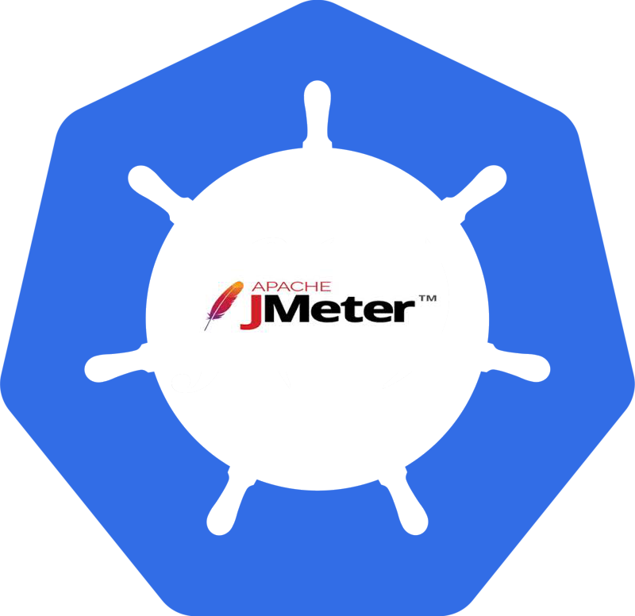
Exercise 7: Load Testing with Apache Jmeter on Kubernetes and OpenShift
A more complete example: https://goo.gl/k5rFpb

Slide 117
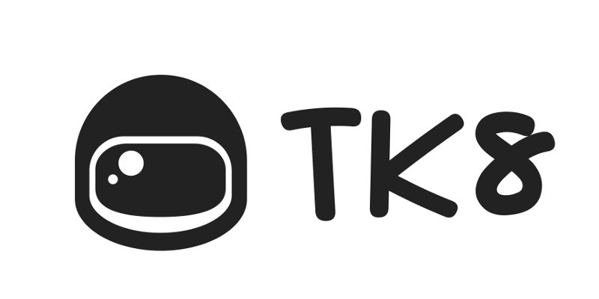
Exercise 8: Running Rancher on Kubernetes
TK8 on Github: https://github.com/kubernauts/tk8

Slide 118

Exercise 9: Kafka Confluent on Kubernetes or OpenShift
Github link:
https://github.com/kubernauts/kafka-confluent-platform

Slide 119

Exercise 10: Strimzi Kafka Operator
Github link:
https://github.com/strimzi/strimzi-kafka-operator
Apache Kafka® on Kubernetes®
→

Slide 120

Exercise 11: Cassandra on Kubernetes
Cassandra Operator →

Slide 121
Get in Touch
Slack - https://kubernauts-slack-join.herokuapp.com/
#kubernetes-teachers on https://kubernetes.slack.com
GitHub - https://github.com/kubernauts
Twitter - @kubernauts
Meetup group - https://www.meetup.com/kubernauts/
And finally, kubernauts.io, kubernauts.de & kubernauts.academy (coming in Q3 / 19)

Slide 122
Tooling and Helpers
Here you go:
The Golden Kubernetes Tooling and Helpers list

Slide 123
Cloud Native Storage Cloud Native Storage on Kubernetes®

Slide 124
Need Training On-Site? https://kubernauts.de

Slide 125
Kubernauts’ Kubernetes Online Training on July 2nd and 3rd https://kubernauts.de/en/training/index.htmlkubernetes-training-course.html

Slide 126

We Love To Learn From You, Join Us, We’re Hiring!
https://kubernauts.de/en/careers/

